Slide 1
Traffic to Tours for Senior Living
Notes:
Presenter's Name
Presenter's Name

Slide 2
Are you doing everything you can to turn your existing web traffic into Leads?
Notes:
How to grow census

Slide 3
Most companies are using or should be using these tactics to generate leads in the Digital World
Create a modern, attractive, well-designed website
Develop an active social media presence with quality content
Digital Marketing Tactics
Drive digital traffic to your website via Organic and PPC
Grow your social followers through content & social proof
Leverage 3rd party referral sites for lead gen

Slide 4
Here are some of the hurdle's companies are facing
Leads are Bouncing
Not the Right Audience
Too Late in Process
Fall Out Before Converting
People are coming to the website but leaving without engaging with you.
Your target audience isn’t who’s coming to your digital channels.
By the time they fill out “Contact Us” they’ve made the decision.
Process and People must be perfectly executed to convert leads to sales.
Traffic
Quality
Journey
Convert

Slide 5
Advantage LEADS: Turn more of your Website traffic to clients
Advantage LEADS
Close
All Website Traffic
Advantage LEADS
Gain more qualified LEADS earlier in the buying process
Advantage LEADS

Slide 6
Five Steps of the Advantage LEADS Conversion Program
ATTRACT
01
“Digital Hook” to attract the right digital audience
ENGAGE
02
Strategically Crafted Self-Assessment to qualify and get buy-in
NURTURE CAMPAIGN
03
Educate, Reinforce, Build Brand Aware-ness, Provide Social Proof, Prep for Call
CONVERT
04
Call task with crafted closing script
MONITOR & MEASURE
05
Track lead progress, guide sales process & measure ROI

Slide 7
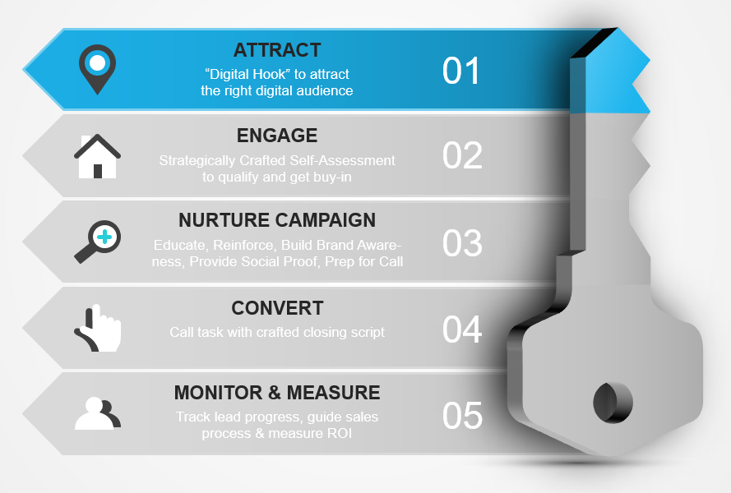
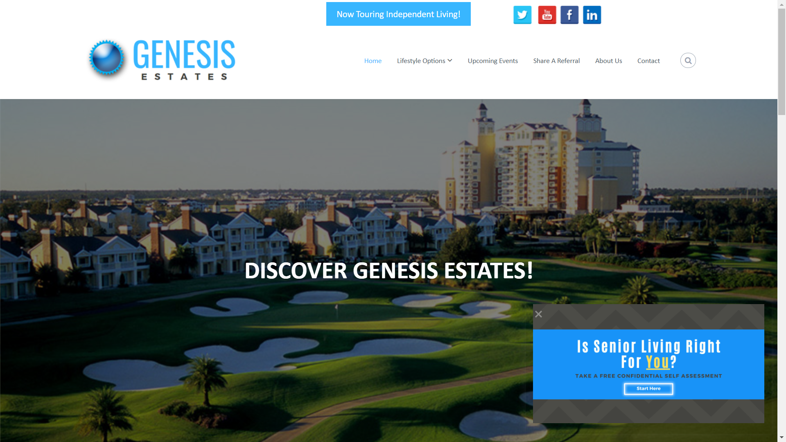
Step 1: Attract
In order to attract the “right” audience, first make sure you have the right content that will draw the audience you want.
Advantage Anywhere | www.AdvantageAnywhere.com | 239-337-2667

Slide 8
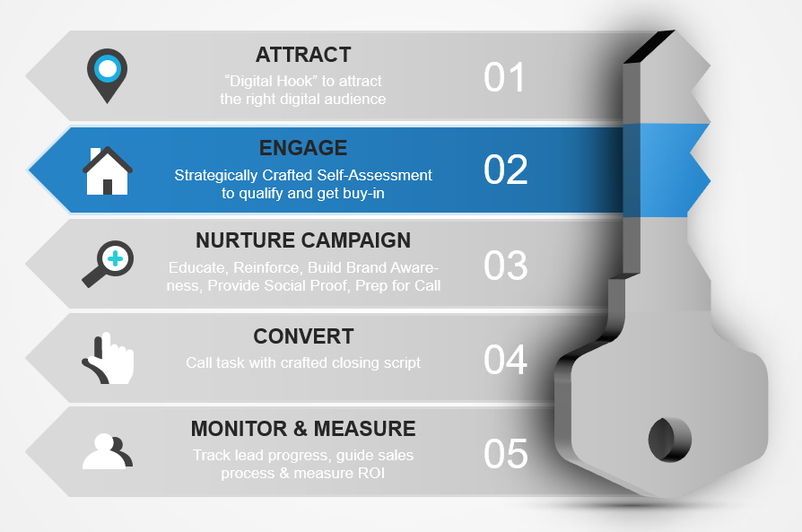
Step 2: Engage
Engage with content and questions they may be asking themselves.
Advantage Anywhere | www.AdvantageAnywhere.com | 239-337-2667

Slide 9
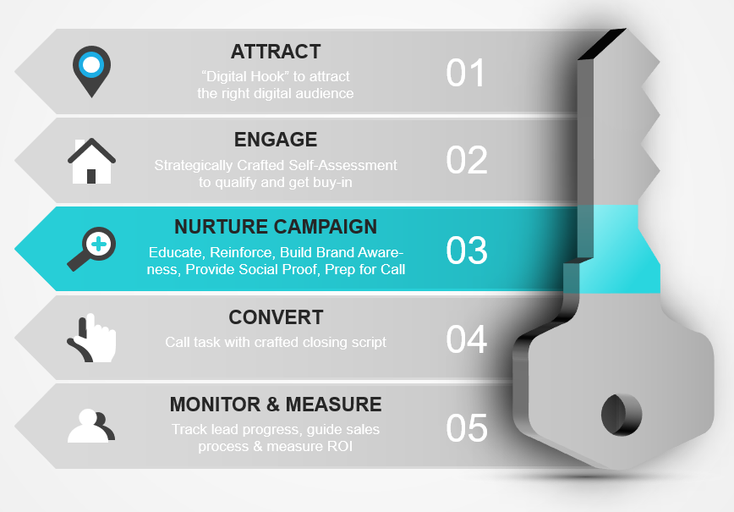
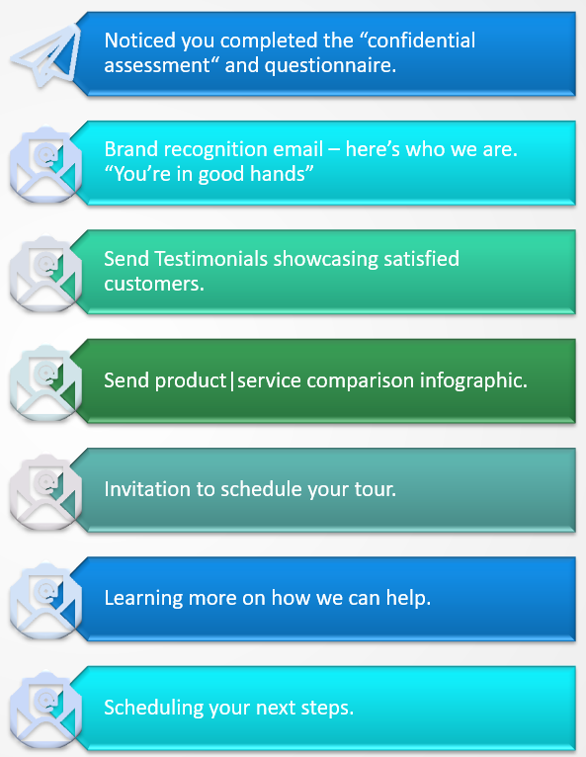
Step 3: Nurture Campaign
Automated nuture Campaign
Hands free automation
Reinforcing their decision to engage
Ability to continuously educate your audience
Create Positive Brand Awareness
Include Testimonials | References
Advantage Anywhere | www.AdvantageAnywhere.com | 239-337-2667

Slide 10
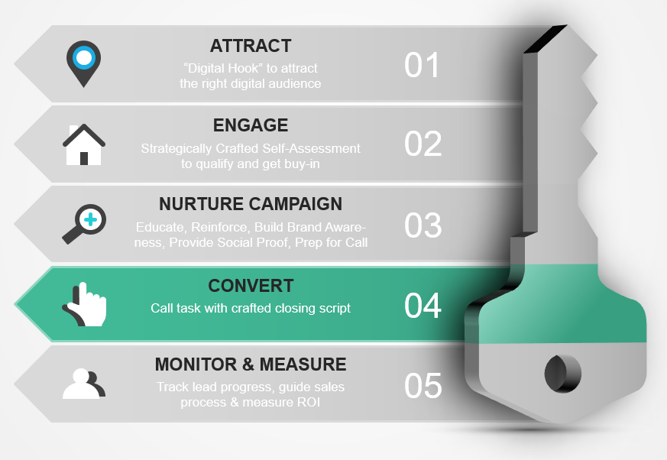
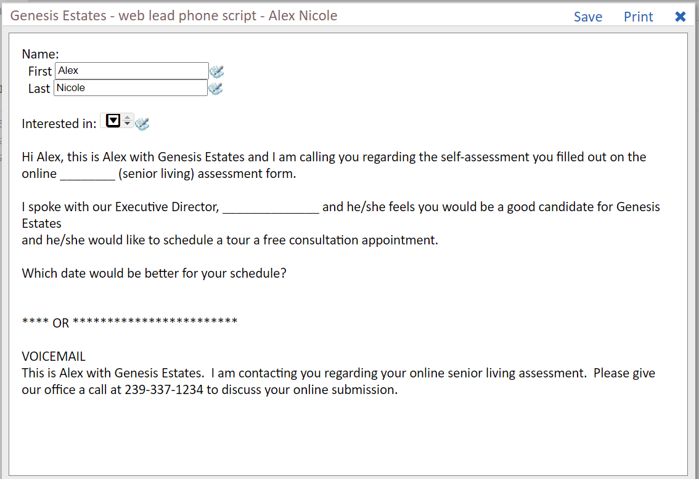
Step 4: Convert
Ensure higher success:
Provide the right script or tools to ask the right questions.
Whether someone is naturally gifted at helping someone through the buyer's journey or this is their first time, we need the right tools and process to convert and move forward.
This provides provide piece of mind during this stage.
Advantage Anywhere | www.AdvantageAnywhere.com | 239-337-2667

Slide 11
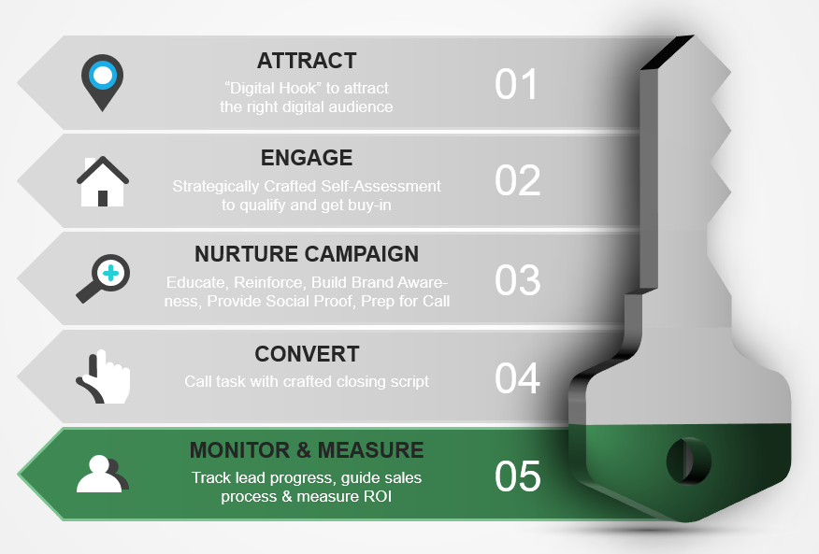
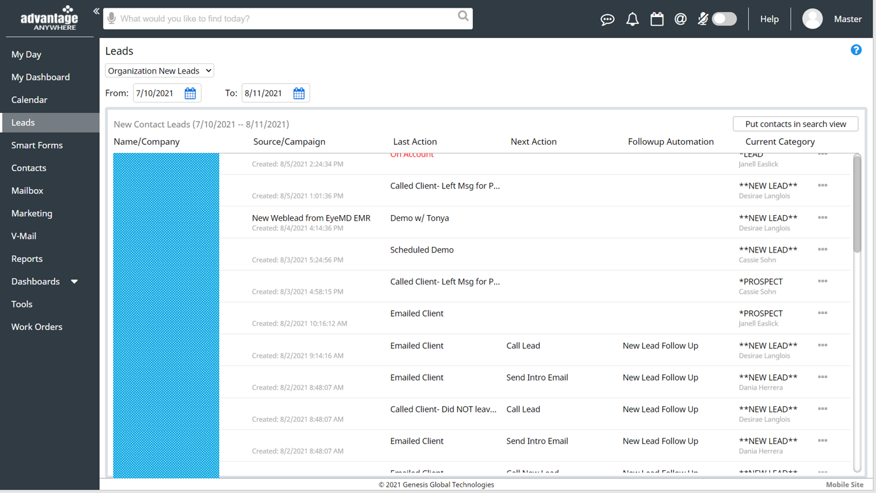
Step 5: Monitor & Measure
Data & Analytics
Lead dashboard and reporting capabilities
Check lead status by date range
Identify conversation rate
Advantage Anywhere | www.AdvantageAnywhere.com | 239-337-2667

Slide 12
Take a free self-assessment at
www.AdvantageAnywhere.com
239-337-2667
Notes:
Our qualifications
Presenter's Name
Presenter's Name

Slide 13
Additional Resources

Slide 14
The Advantage Anywhere 2.0 Ecosystem
01
02
06
Lead Gen
Discovery/Qualify
01
Lead Attraction & Capture (Smart Forms)
Engagement & Nurturing Automation
03
02
Lead Nurture
Click-through Analytics, Metrics and Dashboards.
Marketing Campaigns – Email, Social Posts, Print.
Sales Advancement
07
09
03
Digital Marketing
Dedicated Coaching
04
Census & Sales Management & Analytics
Event Marketing, RSVPs, Follow up & Analytics.
Sales/Census Management
08
04
Event Marketing
08
Referral Marketing & Analytics.
Sales Process Advancement & Efficiency Boosters
Discovery, Qualify & Custom Automation
05
05
Referral Marketing
07
Analytics & Dashboards
09
06

Slide 15
